Slide 1
Suspensions

Slide 2
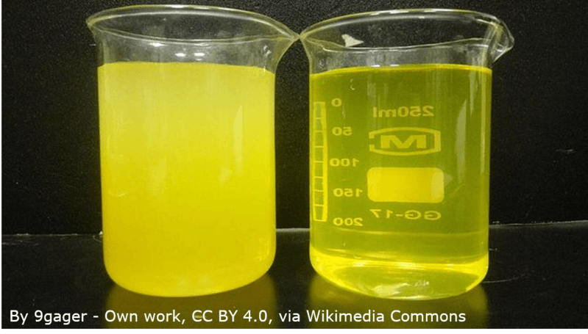
By the end of this lesson you should be able to:
1. | Explain what a suspension is.
2. | Explain how a suspension is different from a solution.

Slide 3
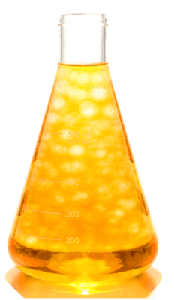
A suspension is made when two substances that are insoluble in each other are mixed.
Insoluble means that the substances are unable to dissolve. Usually one part is a liquid, and the other part floats in the liquid. This makes the mixture cloudy and unclear. Gravity will eventually separate the two parts, creating two layers of substances. This is called "settling out." You can see the cloudy particles of a suspension floating in the image on the right.

Slide 4
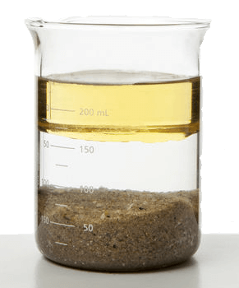
You can, of course, have more than two parts to a suspension.
For example, you can suspend both oil and sand in water at the same time.
The suspension will look like a complete mess at first, but it eventually settles out as in the image below:

Slide 5
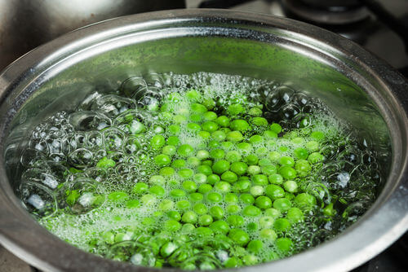
Imagine putting some peas into water to boil.
When you stir them, the peas will be mixed throughout the water. But after they stop being stirred, they drop to the bottom of the pot or float on the top.
This is an example of a suspension.

Slide 6
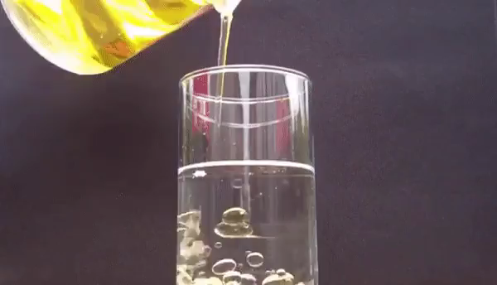
Suspensions have two important properties.
Firstly, suspensions separate over time. Gravity causes the heavier substance to collect at the bottom of a container.
For example, oil will float on water because oil is lighter.

Slide 7
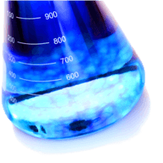
Secondly, suspensions are not homogeneous.
Neither substance is able to dissolve into the other, so they separate instead.
This means that different samples of the suspension will contain different concentrations of each part.

Slide 8
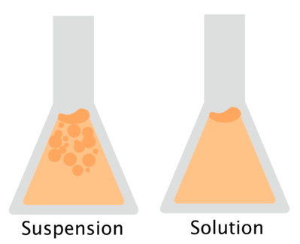
Solutions are made by combining a solute and a solvent, which dissolves the solute into separate particles.
This works because the solute is soluble.
Suspensions are made when the solute is not soluble, so they do not break down into particles.

